Slide 1

Introduction to the Tidyverse

Slide 2
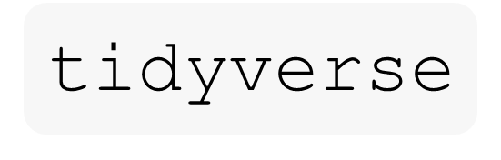
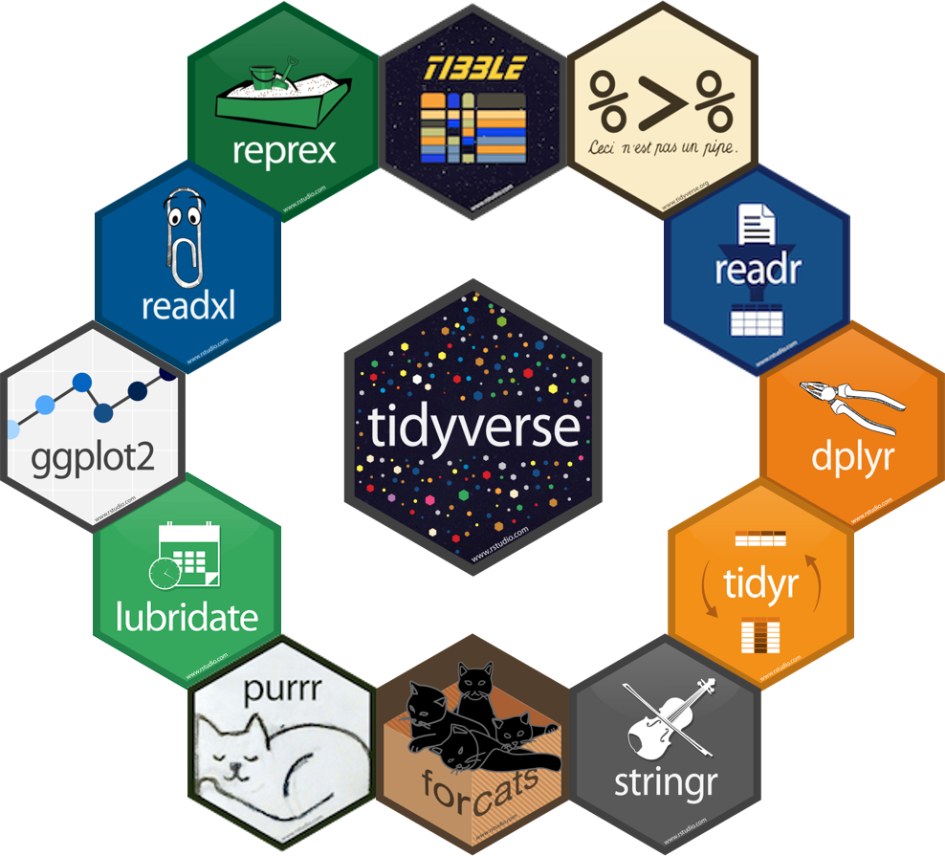
What is the ?
🌐 An ecosystem of R packages Designed for modern, streamlined data science workflows.
🧹 Built on the philosophy of tidy data Makes your datasets easier to manipulate and understand.
🎯 Focused on clarity and efficiency Code is readable, consistent, and easy to debug or extend.
🧱 A modular but integrated toolkit Each package solves a specific problem, but they work better together.
🔧 Powerful tools with minimal syntax Clean verbs and intuitive design = faster learning curve.

Slide 3

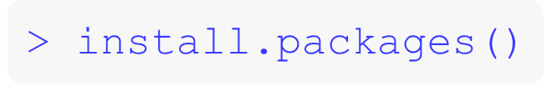
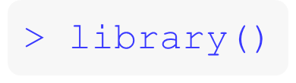
R packages 📦
📦 An R package is a bundle of tools It includes functions, help files, and sometimes data-all wrapped up to solve specific problems.
🛠️ Why use packages?
Reusable code written by experts (sometimes)
Simplifies complex tasks
Save time with pre-written, optimized code
💡Think of packages like R’s “apps” Each one unlocks new tools for analysis, visualization, and more.
💡Key takeaway: If base R doesn’t do it easily—there’s probably a package for that.
dplyr
patchwork
riverdist
vegan
lubridate
ggplot2
mgcv
scales
here
Put a new book on your shelf:
Pull a book from your shelf to use:
Notes:
Install.packages once per computer
Use library() to load the package, once per session

Slide 4
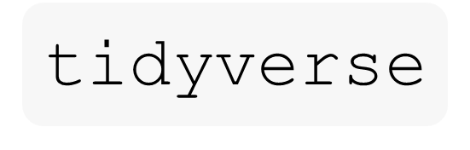
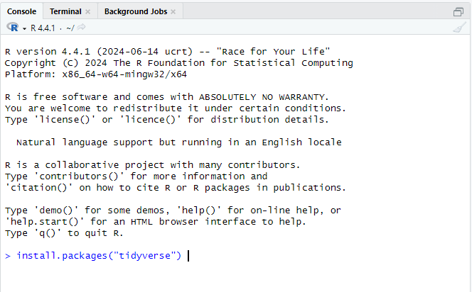
Install

Slide 5
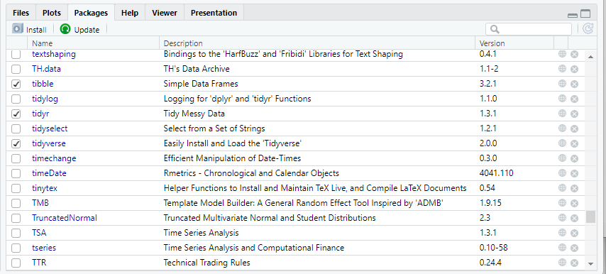
Install

Slide 6
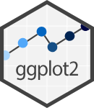





Core packages
ggplot2: data visualizations
dplyr: data wrangling
readr: reading data
tibble: modern data frames
tidyr: data tidying
rmarkdown: combine code, text, and visuals into reproducible documents

Slide 7

“tidy” workflow
The “tidy” workflow from R for Data Science
Notes:
First you import your data into R, Then “tidy” Then transform, QA/QC, summary statistics, filter observations, subset data, create new variables Tidying and Transforming = Wrangling Visualization, Exploratory analysis
Modeling
Communicate, share analysis

Slide 8

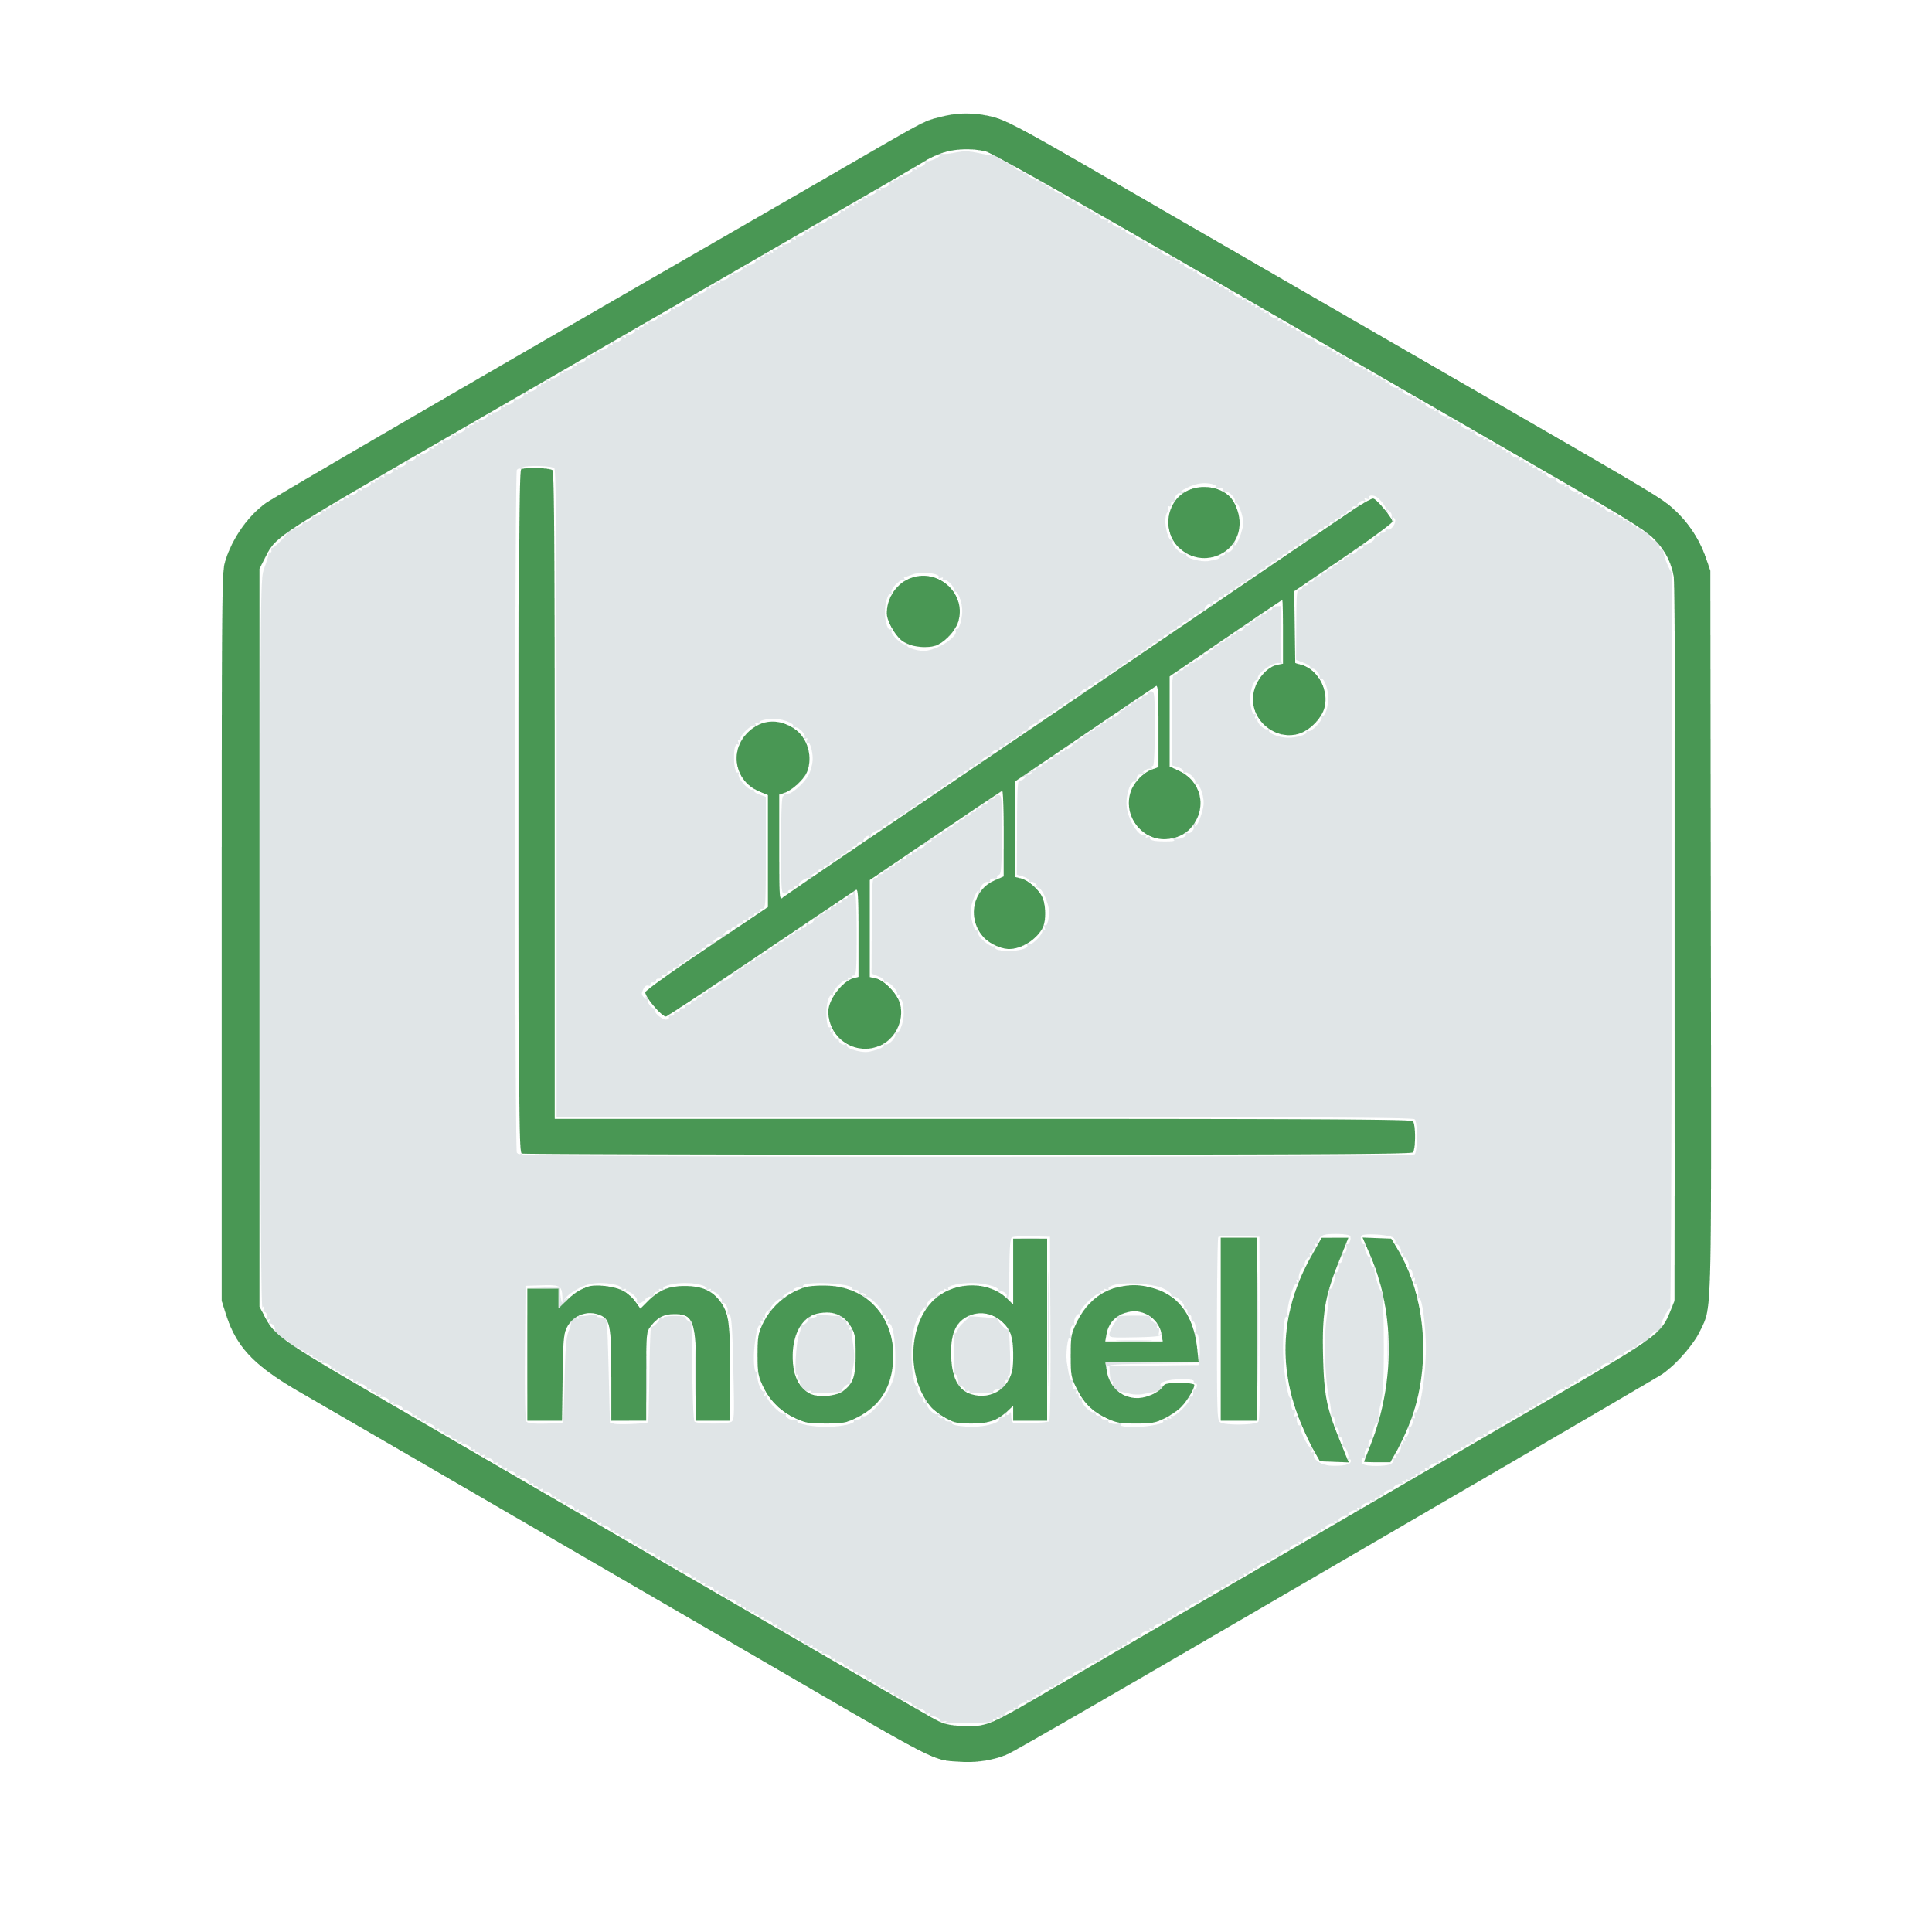





“tidy” workflow
The “tidy” workflow from R for Data Science

Slide 9
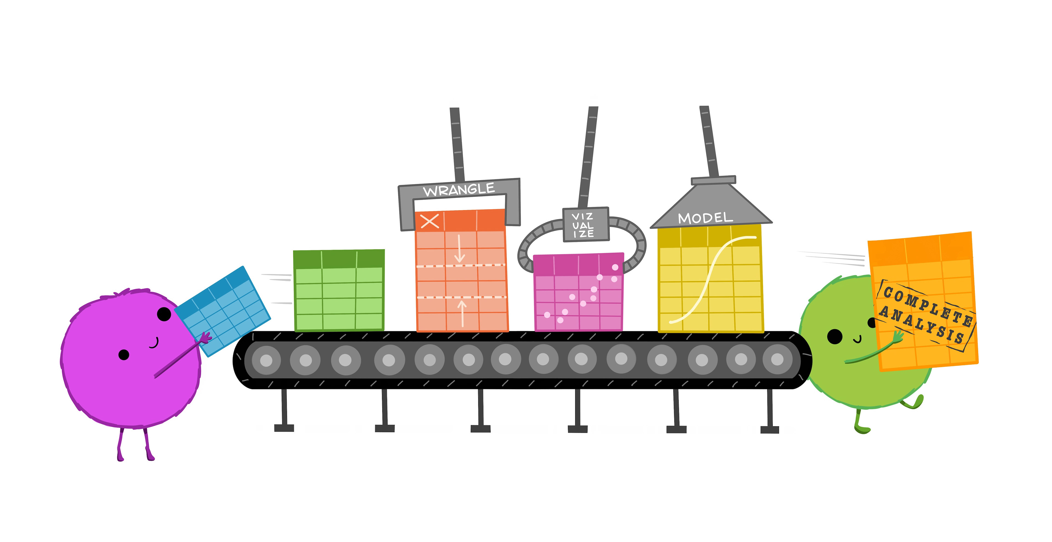
“tidy” workflow
Illustrations from the Openscapes blog Tidy Data for reproducibility, efficiency, and collaboration by Julia Lowndes and Allison Horst

Slide 10
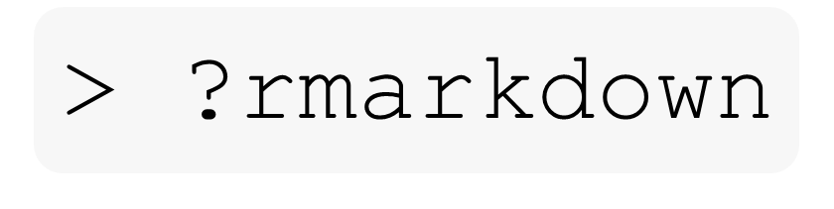
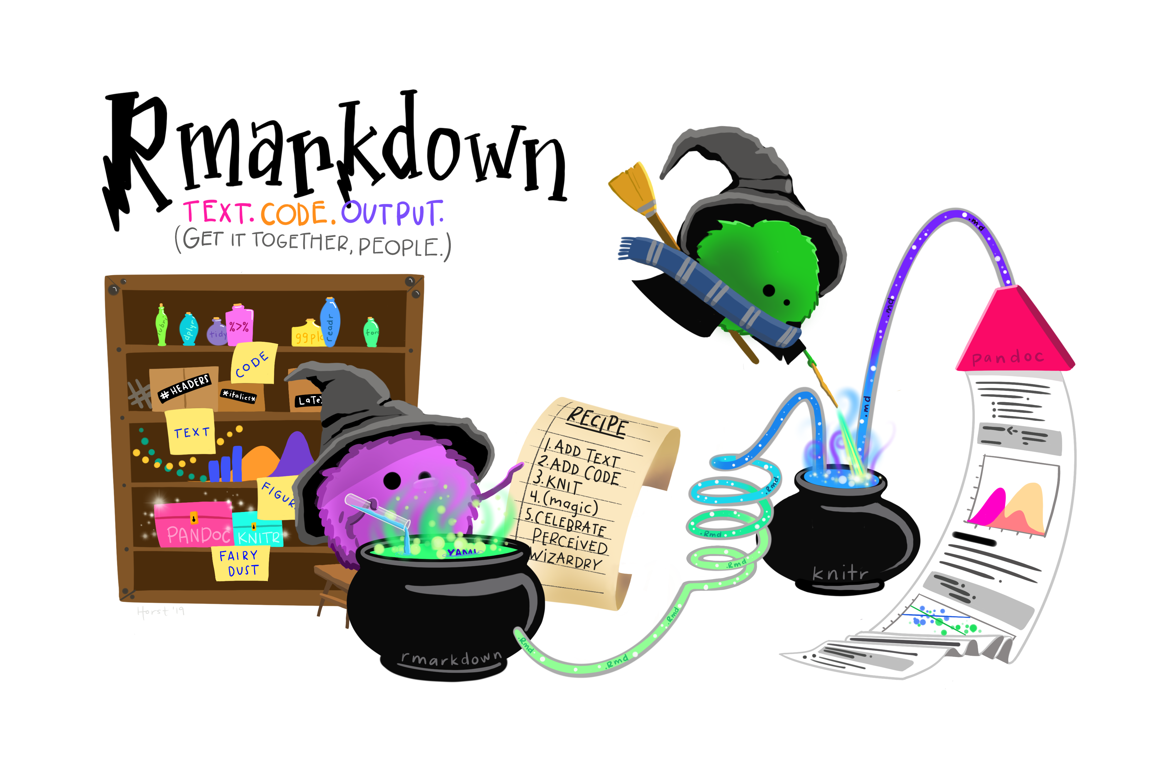
📝 Combine code, text, and visuals in one polished file 💻 Run live R code inside your document 📊 Display plots, tables, and model output 🧶 Knit to HTML, PDF, or Word with one click 📂 Organize and share reproducible work with ease
Artwork by @allison_horst

Slide 11
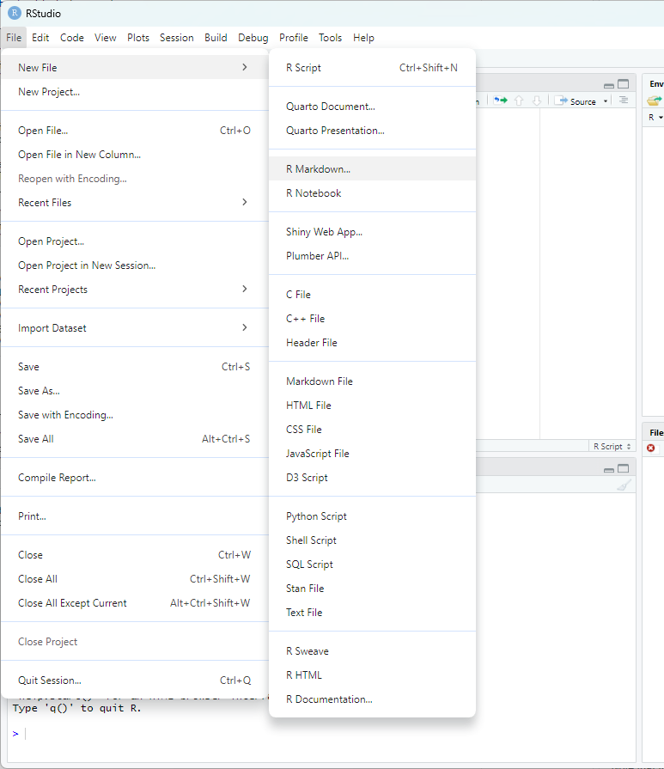
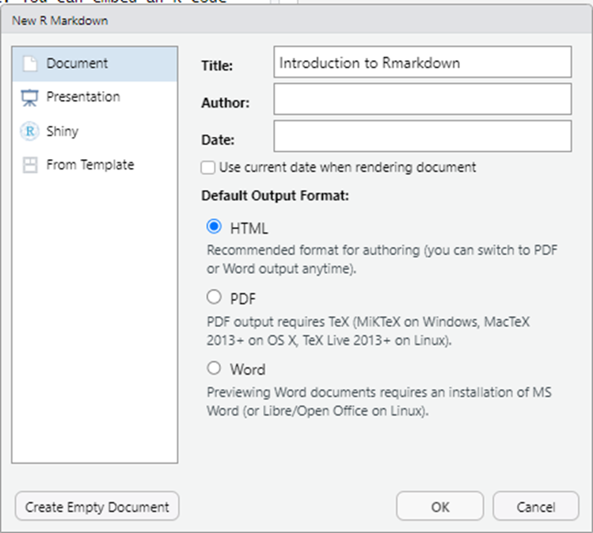
File > New File > R Markdown…

Slide 12
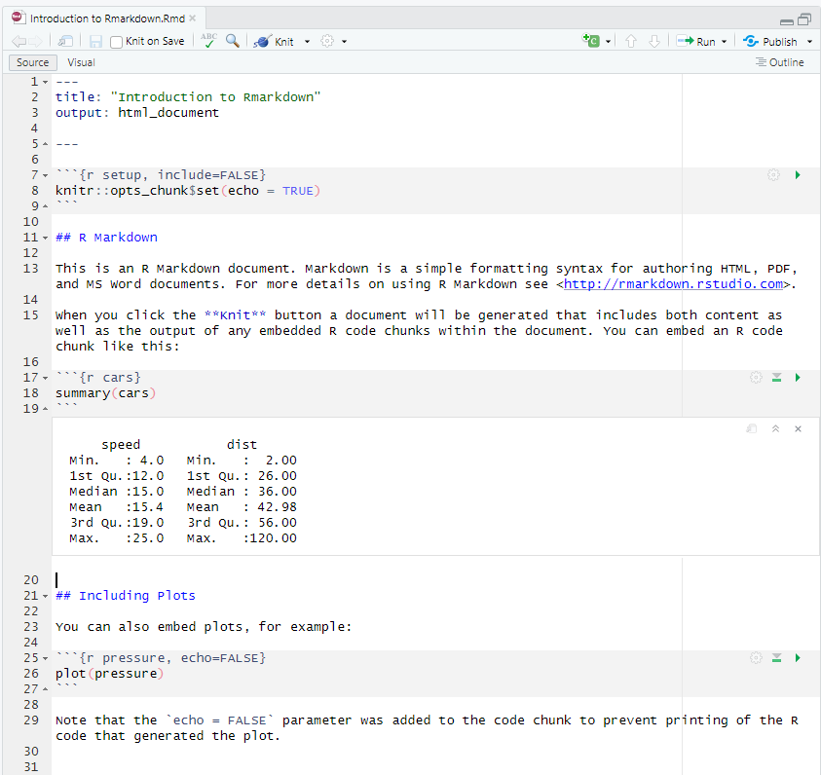
YAML header surrounded by _ _ _
Plain text in markdown
R code chunk surrounded by ```{r} r-code-here () ```
Code Output

Slide 13
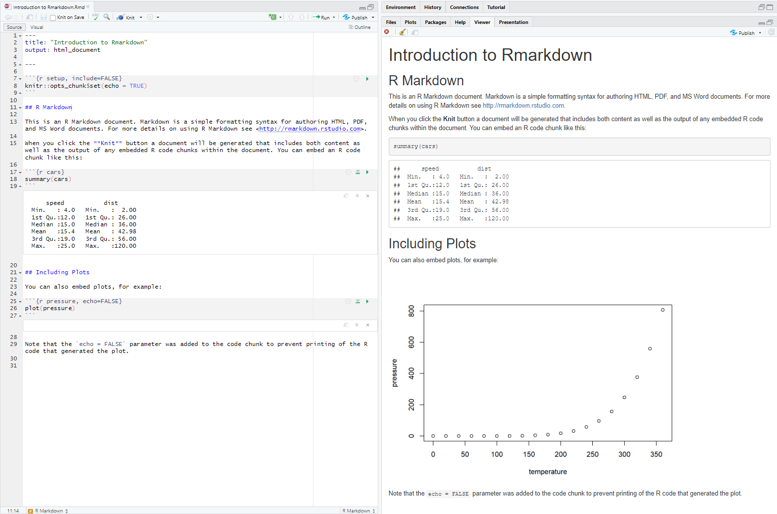

Slide 14

Navigate to IntroToRmarkdown.Rmd
Work through the .Rmd to get familiar with using Rmarkdown.
🤚feel free to ask any questions
Artwork by @allison_horst

Slide 15
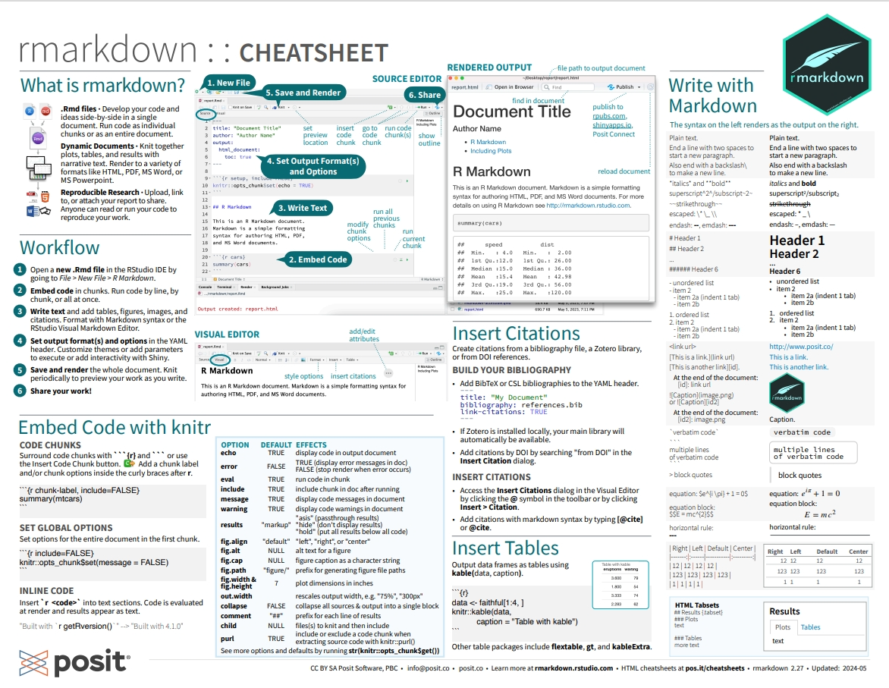

Slide 16


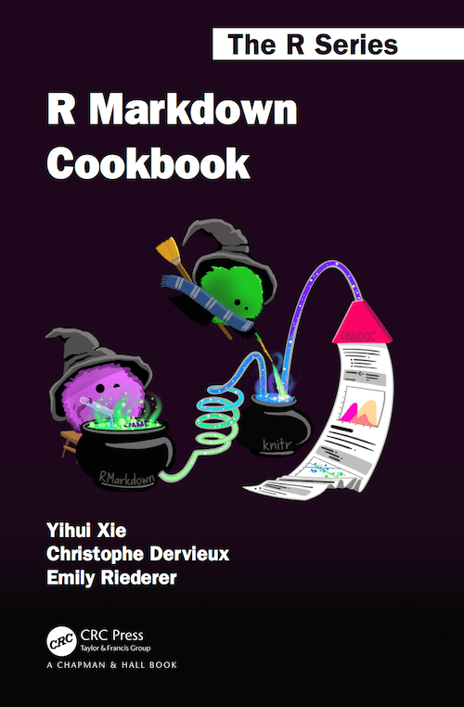
Welcome | R for Data Science
R Markdown: The Definitive Guide
R Markdown Cookbook

